Slide 1
Mid-Term Review
COMP / IT 420
Lecture 7, March 8th, 2021

Slide 2
Midterm Details
Midterm is to be completed alone. Do not work together. Any hint of collaboration or suspiciously similar answers will result in an automatic zero on the exam and a plagiarism report. This is a full final letter grade reduction and potential dismissal from class.
Late mid-terms will not be graded. Do not wait until the last minute to start as this is 10% of your total grade.

Slide 3
Midterm Details Continued
Midterm will be released at 9am on Wednesday March 10th, 2021.
The regular lab interval is scheduled for Wednesday. I will go over the mid-term and allow time for questions and clarifications. After that I will be available through normal channels for questions, including email and the course Discord.

Slide 4

Midterm Details Continued
Midterm will require you to create an ERD diagram in draw.io.
There is SQL on the exam.
You will be provided with an ERD to construct queries. Since you have a lot of time, you could potentially implement the ERD in MySQL with dummy data to check your queries. This is not required and will not garner extra points.

Slide 5
Midterm Details Continued
There are free response questions on the examination. Please use your own words in answering. Do not copy text verbatim from the textbook or other sources, this will be considered plagiarism.
You can submit the mid-term more than once if you want to update an answer. I would recommend not waiting until the end of the testing interval to try and submit it.

Slide 6
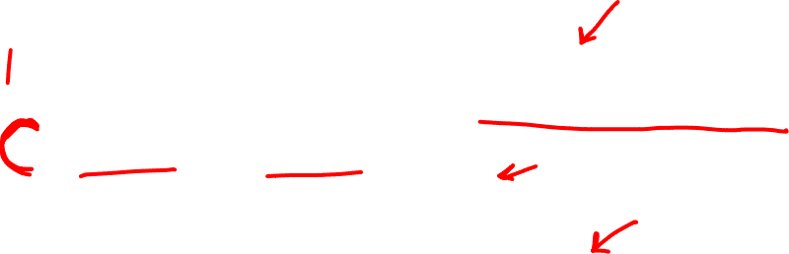
Mid-term Topics Review
Advantages of RDBMS Systems
ERD Generation and Analysis
Basic SQL Statements
DML: Querying, Updating, Deleting
DDL: Table Creation
Advanced SQL Objects
Procedures, Functions, Triggers
Keys
Normalization

Slide 7
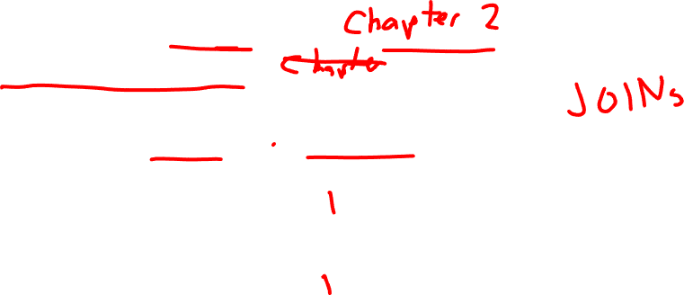
RDBMS Systems
C & M Chapter 1.4 – 1.7
What are the advantages and disadvantages of RDBMS?
What problems do they solve?
What problems do they create?

Slide 8

RDBMS Advantages
Avoid data anomalies through strict relations
Separate physical implementation from logical structure of the data
Provide security and access controls
Centralize and normalize data for an organization
SQL standard provides uniformity for data access through DML and DDL commands.

Slide 9

RDBMS Disadvantages
Large systems are complex and complex queries might take a long amount of time
Potential for vendor lock-in if using advanced features
Sparse data sets do not work well due to memory overheard for empty space.

Slide 10
Conceptual Model
An abstraction of the physical database.
Macro-level view of data environment
Basis for the identification and high-level description of the main data objects
Software and hardware independent

Slide 11
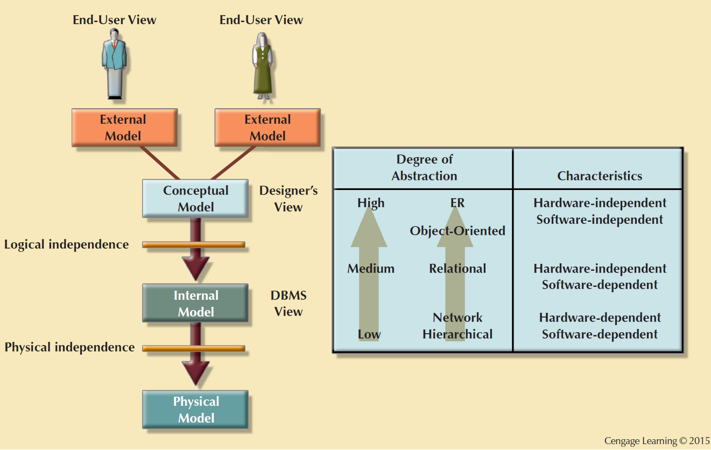
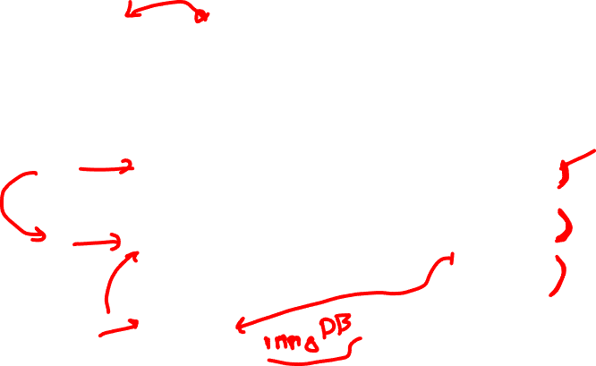

Slide 12
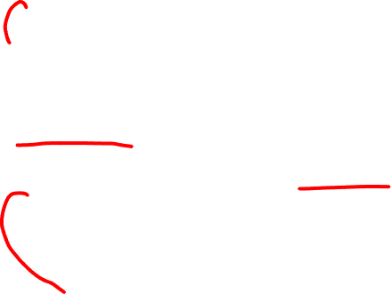
ERD Generation and Analysis
Attributes and datatypes
- Primary and foreign keys
- Implications of datatypes (how to choose)
Connectivity
- Relationships and Crow’s Foot notation
Normalization
- Identifying normalization
- Implementing normalization and denormalization

Slide 13
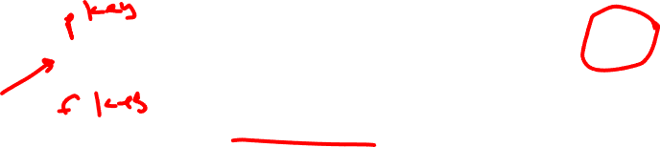
Entity and Referential Integrity
A ______ ensures entity integrity and is required for 1NF.
A ______ ensures referential integrity.

Slide 14

Entity and Referential Integrity
A primary key ensures entity integrity and is required for 1NF.
A foreign key ensures referential integrity.
Entity integrity – ????
Referential integrity – ????

Slide 15

Entity and Referential Integrity
A primary key ensures entity integrity and is required for 1NF.
A foreign key ensures referential integrity.
Entity integrity – uniquely identifies an entity instance
Referential integrity – references to an entity are valid and correct

Slide 16


Functional Dependence
Determination: Knowing one attribute determines the value of another attribute
Determinant: Attribute whose value determines another
DolphinId can determine student info including address information.
Dependent: Attribute whose value is determined by the other attribute
Student Name (FNAME + LNAME) or Address (STREET + APT + CITY + STATE + ZIP) is determined by DolphinId.

Slide 17

Functional Dependence
STU_DOLPHIN_ID -> STU_LNAME
Determinant
Dependent

Slide 18
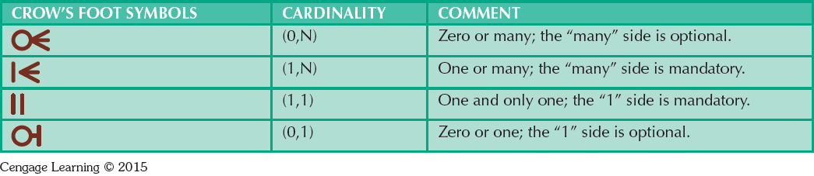
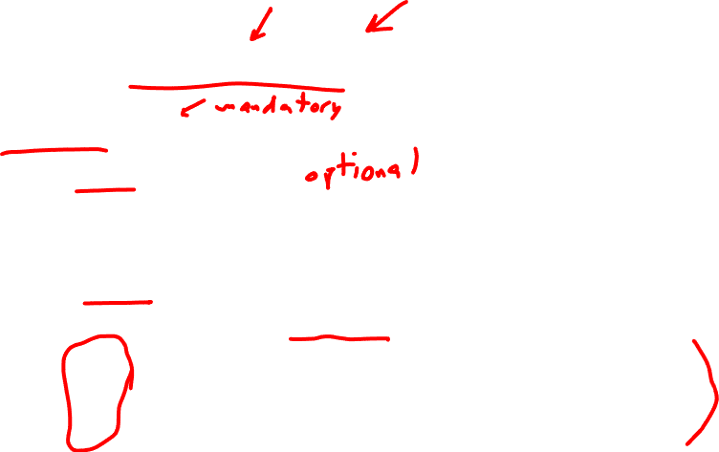
Entity Connectivity
One-to-many (1:M) – e.g. a PAINTER paints many PAINTINGS
Zero-to-many (0:M)
Many-to-many (M:N) – e.g. many STUDENTS can take many CLASSES
One-to-one (1:1) – e.g. a person has one social security number
Zero-to-one (0:1)

Slide 19
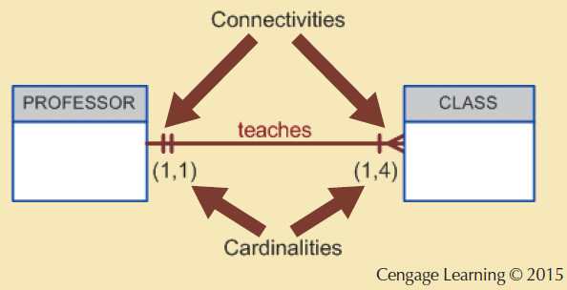

Connectivity and Cardinality

Slide 20
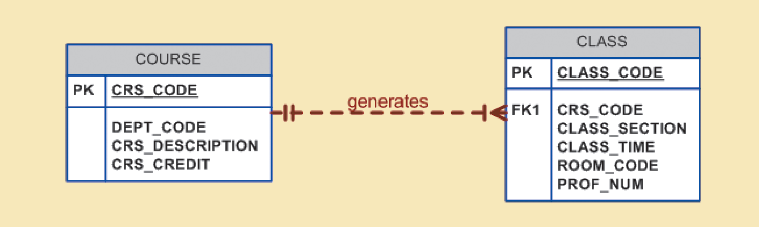

Strong and Weak Entities
Strong entities in _____ relationships
A strong entity is ___________ and does not share a key component

Slide 21

Strong and Weak Entities
Strong entities in weak relationships
A strong entity is __________ and does not share a key component

Slide 22

Strong and Weak Entities
Strong entities in weak relationships
A strong entity is entity independent and does not share a key component
???

Slide 23

Strong and Weak Entities
Strong entities in weak relationships
Strong entity is entity independent and does not share a key component

Slide 24
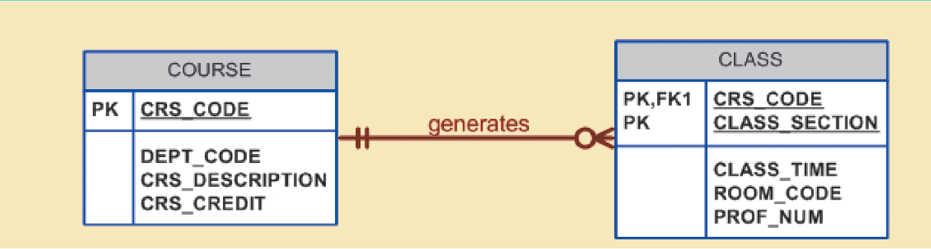
Strong and Weak Entities
Weak entities in _____ relationships
Weak entities are _______ and _________.
???

Slide 25

Strong and Weak Entities
Weak entities in strong relationships
Weak entities are _______ and _________.
???

Slide 26
Strong and Weak Entities
Weak entities in strong relationships
Weak entities are entity dependent and _________.
???

Slide 27

Strong and Weak Entities
Weak entities in strong relationships
Weak entities are entity dependent and share key components.
???

Slide 28
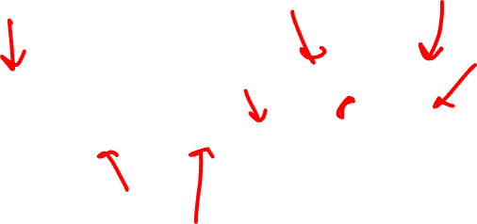
Strong and Weak Entities
Weak entities in strong relationships
Weak entities are entity dependent and share key components

Slide 29
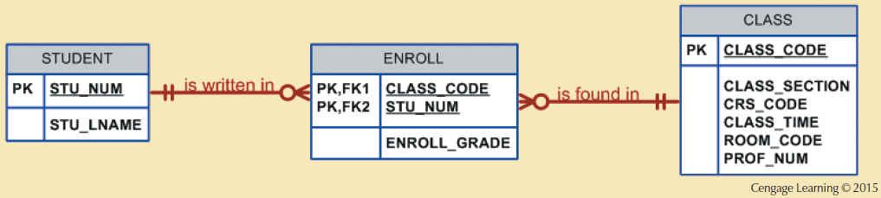

Associative Entities
Used to instantiate many-to-many relationships
???
???

Slide 30
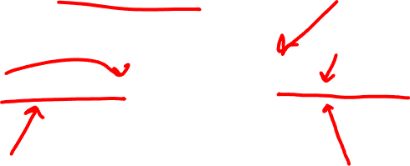
Associative Entities
Used to instantiate many-to-many relationships
???
???

Slide 31
Associative Entities
Used to instantiate many-to-many relationships
???

Slide 32

Associative Entities
Used to instantiate many-to-many relationships

Slide 33
Analysis Exercise
Determining where the previous information is present on ERDs.
Knowing what is strong / weak (in entities and relationships.)
Understanding keys and determination.

Slide 34
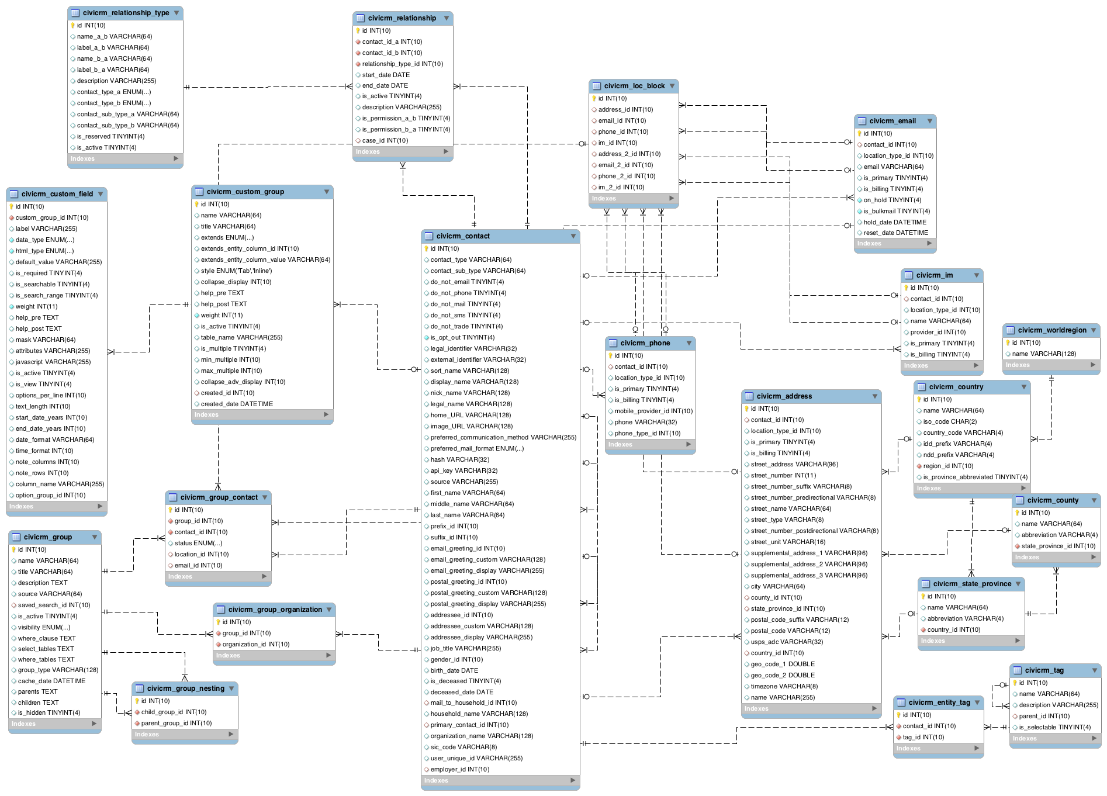
Analysis Exercise

Slide 35
That was a joke!

Slide 36
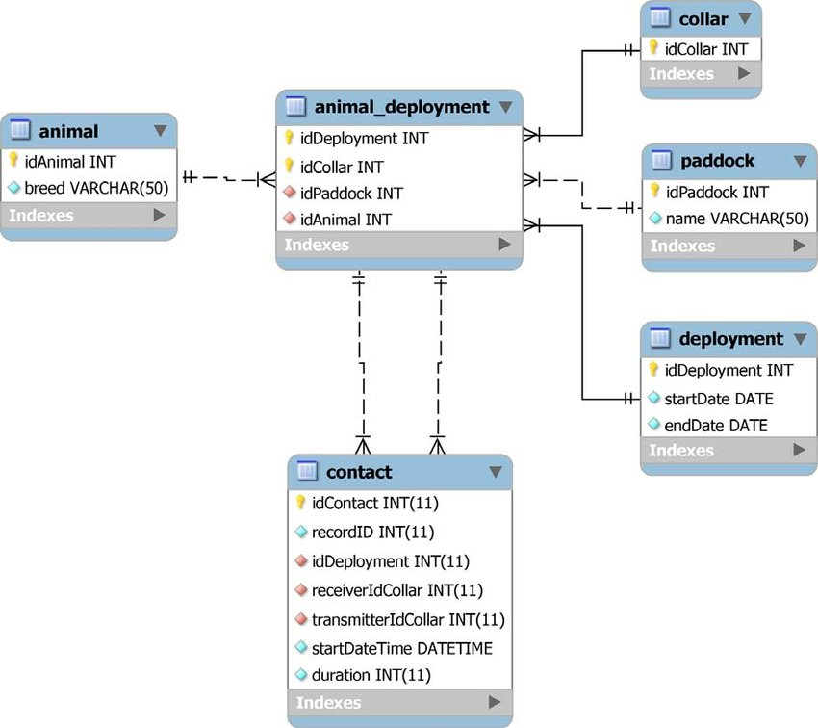


Slide 37
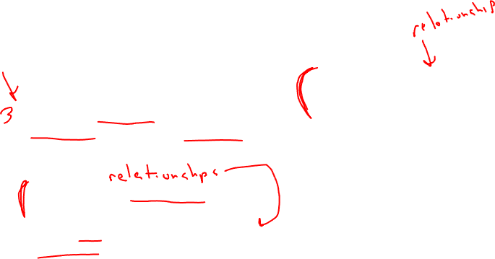
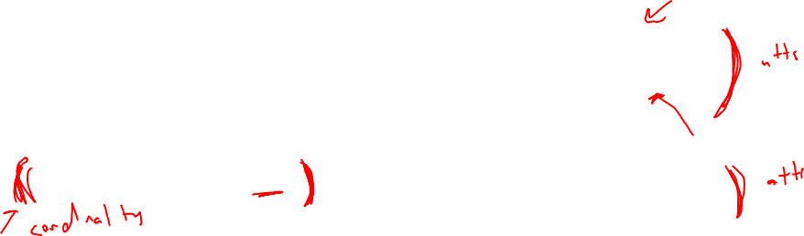
ERD Creation Exercise
I’m working on a new database for my COMP 420 assignments. I need to track each student, each assignment and each section of the class.
Each student can submit multiple assignments.
Each section can have multiple assignments.
Each section is limited to 24 students.
A student can only be enrolled in one section.
Each assignment has an assignment id, a name, a due date and a grade out of 40 points (there can be decimals.)
Each student is listed by dolphin id, first and last name, and major.

Slide 38

Categories of SQL
Data definition language (DDL)
defines the structure of the database
creating tables and constraints
Data manipulation language (DML)
allows for retrieval of database data
allows for creation and deletion of database data

Slide 39

Creating Table Structures
Syntax to create table
CREATE TABLE tablename(field metadata);
Formatting Technique
Use one line per field (attribute) definition
Capitalize SQL commands
Line up attribute characteristics and constraints and follow order precedence.
Features of table creating command sequence
NOT NULL specification
UNIQUE specification

Slide 40

CREATE USER TABLE
Table creation command
CREATE TABLE USER
(
UID INT(9) NOT NULL AUTO_INCREMENT PRIMARY KEY, NAME VARCHAR (36) NOT NULL,
CREATED_ON DATETIME NOT NULL
)
ENGINE=INNODB;
Field metadata
InnoDB is transaction-safe engine, there are others available
with different effects on data retrieval and input.
Book may incorrectly state that MyISAM is default.

Slide 41
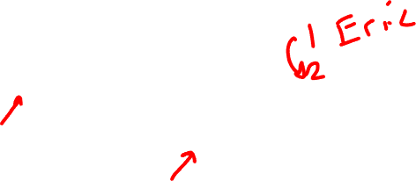
CREATE USER TABLE
CREATE TABLE USER
(
UID INT(9) NOT NULL AUTO_INCREMENT PRIMARY KEY, NAME VARCHAR (36) NOT NULL,
CREATED_ON DATETIME NOT NULL
)
ENGINE=INNODB;
SQL statements end with a semicolon (delimiter)
InnoDB is transaction-safe engine, there are others available
with different effects on data retrieval and input.
Book may incorrectly state that MyISAM is default.

Slide 42
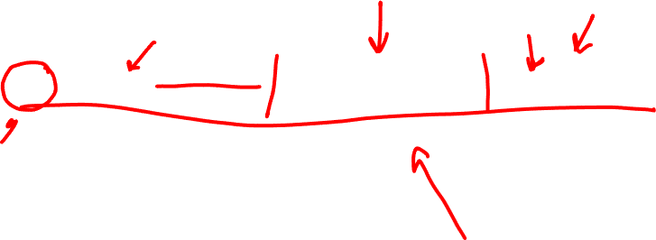
Field Metadata
UID INT(9) NOT NULL AUTO_INCREMENT PRIMARY KEY
Field name, datatype, field constraints
Field name?
Datatype?
Constraints?

Slide 43
CREATE USER TABLE
Table creation command
CREATE TABLE USER
(
UID INT(9) NOT NULL AUTO_INCREMENT PRIMARY KEY, NAME VARCHAR (36) NOT NULL,
CREATED_ON DATETIME NOT NULL
)
ENGINE=INNODB;
Field metadata

Slide 44
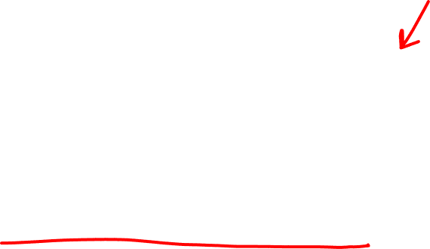
Datatypes
How do you select the correct datatype for a field?
What are the correct input and output datatypes (if applicable) if using stored procedures and functions?
INT, CHAR(N), VARCHAR(N), DECIMAL(N,M), etc.

Slide 45
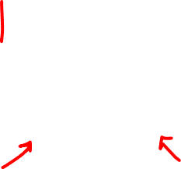
Primary Key Constraint
UID INT(9) NOT NULL AUTO_INCREMENT PRIMARY KEY
PRIMARY KEY automatically enforces
NOT NULL
UNIQUE – non-duplicated
Can also be declared separately with:
PRIMARY KEY (UID)

Slide 46
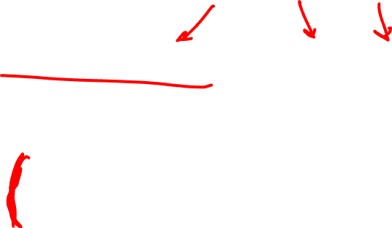
Foreign Key
FOREIGN KEY (V_CODE) REFERENCES VENDOR (V_CODE) ON UPDATE CASCADE
Enforced only if relationship is established.
ANSI SQL allows
ON DELETE CASCADE
If parent record is deleted, all foreign key records are deleted
ON UPDATE CASCADE
If parent record key is updated, update all foreign key records
SET NULL
SET DEFAULT

Slide 47

Composite Primary Key
CREATE TABLE LINE (
INV_NUMBER int,
LINE_NUMBER int,
P_CODE varchar(10),
LINE_UNITS float(8),
LINE_PRICE float(8),
PRIMARY KEY (INV_NUMBER, LINE_NUMBER),
FOREIGN KEY (INV_NUMBER) REFERENCES INVOICE(INV_NUMBER),
FOREIGN KEY (P_CODE) REFERENCES PRODUCT(P_CODE)
) ENGINE=INNODB;

Slide 48
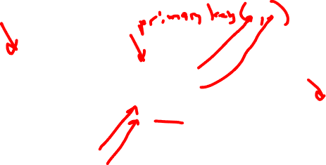

Slide 49

SQL DML
SELECT statements and projection
JOIN statements
Constraints (WHERE and IN)
Stored procedures, functions and triggers
Aggregation (COUNT, AVG, MAX, GROUP BY, ORDER BY, etc.)
UPDATE, INSERT, DELETE

Slide 50

Selecting Rows Using Conditional Restrictions
Rows are restricted based on the conditions list:
SELECT column_list (attributelist)
FROM table_list
[WHERE condition_list];
Used to select partial table contents by placing restrictions on the rows
Optional WHERE clause
Adds conditional restrictions to the SELECT statement

Slide 51
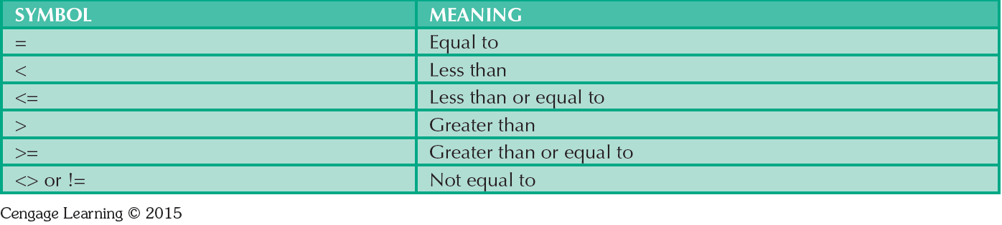
Comparison Operators
Will not work with NULL
Can use with datatypes other than numbers

Slide 52
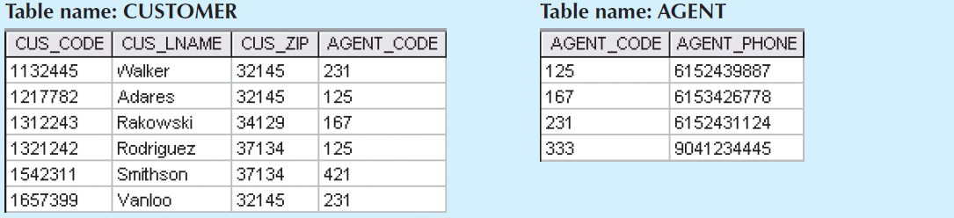

Joins in SQL
Attributes
SELECT CUS_LNAME, AGENT_PHONE
FROM CUSTOMER
JOIN AGENT
ON CUSTOMER.AGENT_CODE=AGENT.AGENT_CODE
Can also use JOIN AGENT USING (AGENT_CODE)
Tables
Intersection

Slide 53
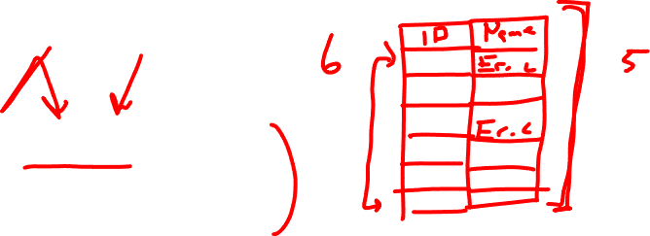
COUNT
SELECT COUNT(DISTINCT v_code)
FROM product
WHERE p_price <= 10.00;
SELECT COUNT(*)
FROM product
WHERE p_price <= 10.00;

Slide 54
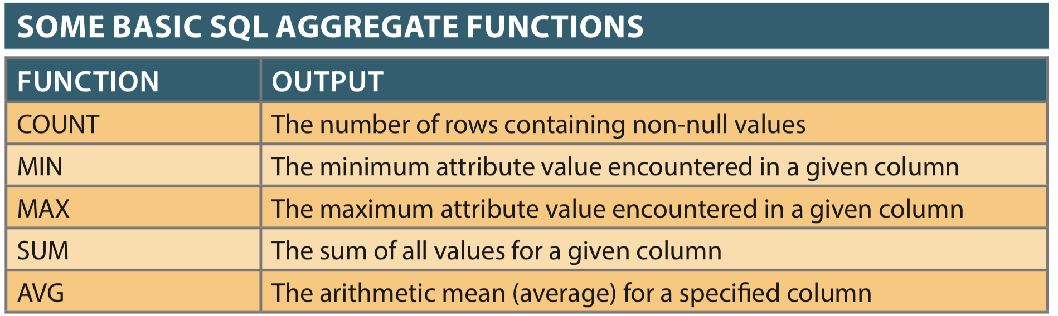

Aggregate Functions
Return a VALUE based on input rows

Slide 55
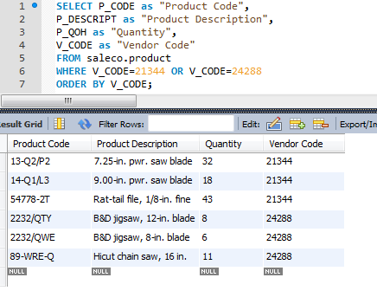
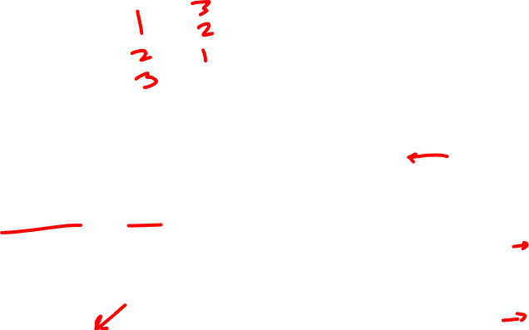
Ordering
ORDER BY clause selects ordering behavior
ORDER BY attribute ASC
ORDER BY attribute DESC
ORDER BY attr_1, attr_2, ...

Slide 56

Inserts into SALECO
INSERT INTO table VALUES (value1, value2...);
INSERT INTO vendor
VALUES (24543, ‘CSUCI’, ‘Ekho’, ‘805’, ‘111-1111’, ‘CA’, ‘Y’);
INSERT INTO product
VALUES (‘8050-EKHO’, ‘Ekho Dolphin Chow’, 20190916, 10,10,18.99,0,24543);
Is order important?

Slide 57
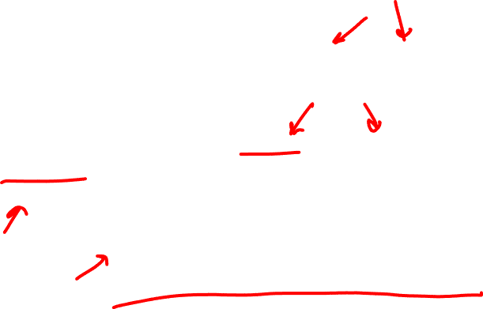
Insert without all values
INSERT INTO table(attribute_1,attribute_2,...) VALUES (attribute_1_value, attribute_2_value, ...)
INSERT INTO product(p_code, p_descript) VALUES (‘BRT-345’, ‘Titanium drill bit’)
What happens to other values in record?
Auto Incremented fields do NOT need to have data inserted.

Slide 58

Stored Procedures and Defined Functions
Procedure
Named collection of SQL statements
User Defined Functions
Returns based on input
Advantages
Reduce network traffic and increase performance
Reduce code duplication by means of code isolation and code sharing

Slide 59

Stored Procedure Syntax
DELIMITER delimiter_characters
CREATE PROCEDURE procedure_name ([IN] parameter_1, parameter_2)
BEGIN
…SQL statements;
END delimiter_characters
DELIMITER ;

Slide 60
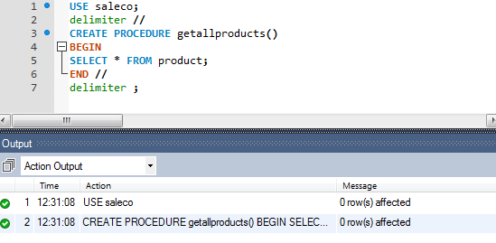
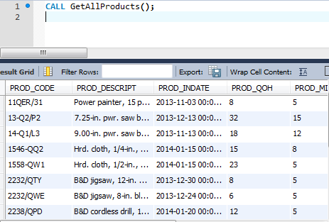
Stored Procedure Example

Slide 61
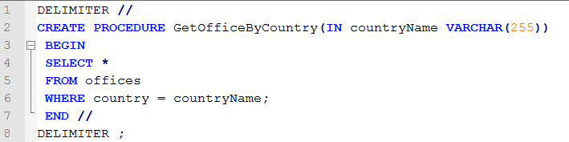
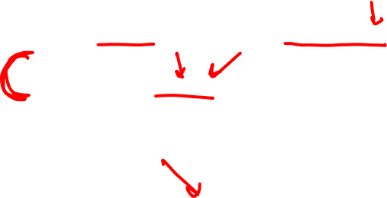
Stored Procedure Example (2)
Parameter
Arguments
CALL GetOfficeByCountry('USA')

Slide 62
User Defined (Stored) Function Syntax
DELIMITER $$
CREATE FUNCTION function_name(param1, param2,…)
RETURNS datatype
[NOT] DETERMINISTIC
BEGIN
-- statements
END $$
DELIMITER ;

Slide 63
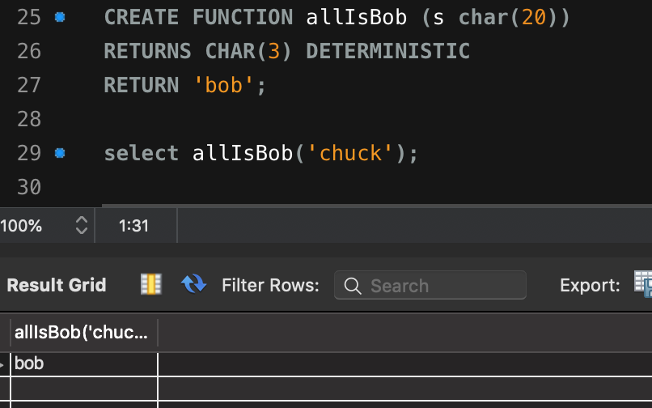
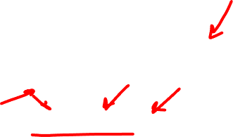
Function Example (MySQL)

Slide 64
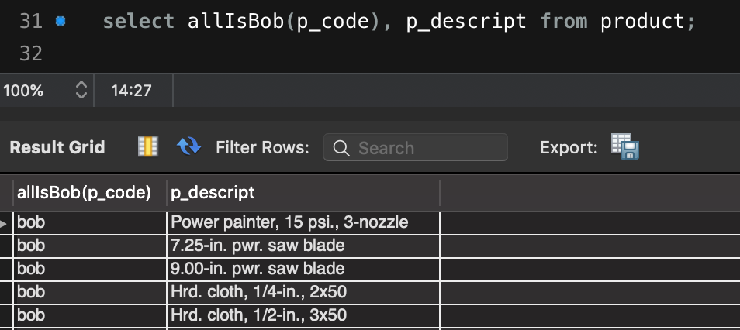

Functional Example (MySQL)

Slide 65
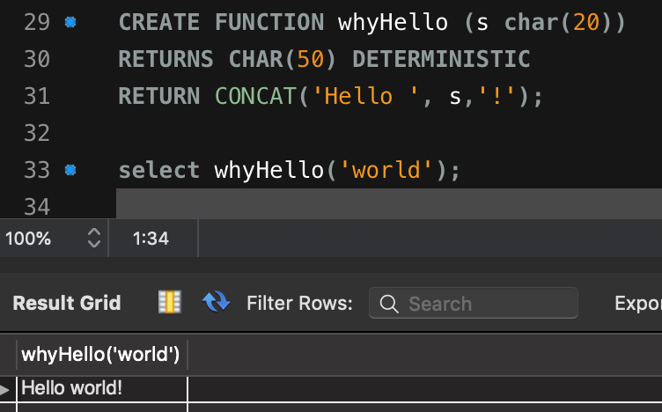
Functional Example (MySQL)

Slide 66
Triggers
SQL code that is invoked (triggered) when a DML event occurs
Triggering timing - Indicates when trigger’s PL/SQL code executes
Triggering event - Statement that causes trigger execution (UPDATE, INSERT, DELETE)
Triggering level - Statement- and row-level
Triggering action - PL/SQL code enclosed between the BEGIN and END keywords

Slide 67
Triggers
DROP TRIGGER trigger_name command
Deletes a trigger without deleting the table
Trigger action based on DML predicates
Actions depend on the type of DML statement that fires the trigger

Slide 68
Triggers
BEFORE and AFTER triggers
Both triggers will fire on triggering statement
Manipulation occurs before or after triggering statement operation
NEW and OLD
States of values to change in trigger body
NEW values on INSERT and UPDATE
OLD values on UPDATE and DELETE
OLD is read-only (since it is being modified by the triggering statement)

Slide 69
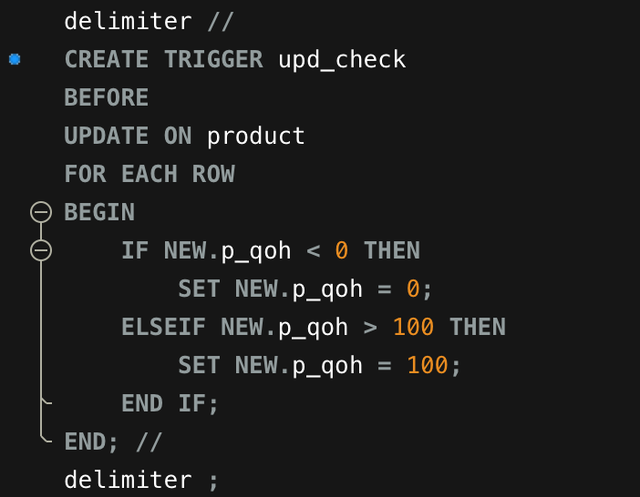
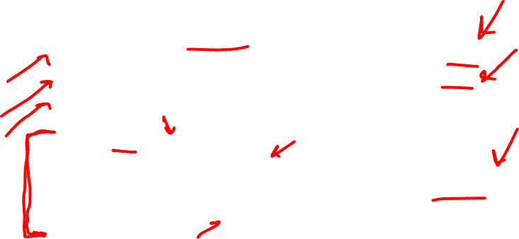
Trigger Example (1)
Triggering Timing
Triggering Event
Triggering Level
Triggering Statement

Slide 70
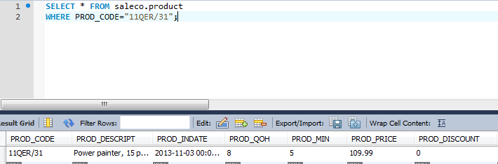
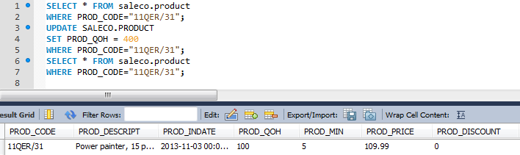
Trigger Example (2)

Slide 71
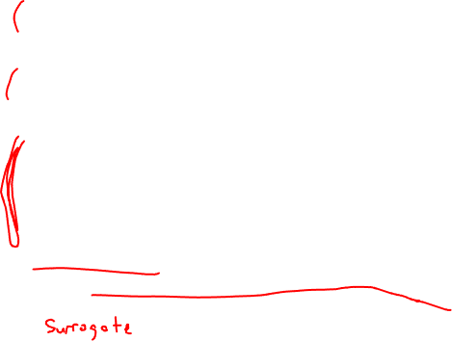
Keys!!
Primary Key
Identifier composed of one or more attributes that uniquely identifies a row
Foreign Key
An attribute in one table whose values must match the primary key in another table, or be NULL
Super Key
An attribute or attributes that uniquely identify each entity in a table
Candidate Key
A minimal superkey, a key that cannot be reduced further without losing integrity
Secondary Key
A key used for data retrieval purposes, a specific use case

Slide 72
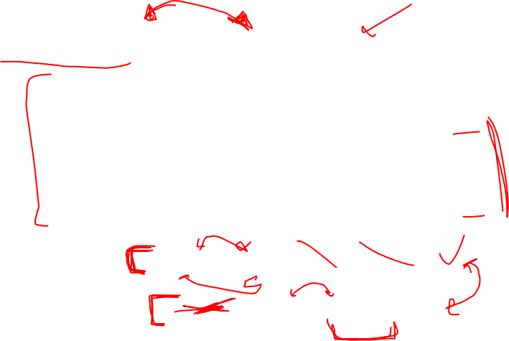
Candidate and Super Key
year month date major minor
2008 01 13 0 1
2008 04 23 0 2
2009 11 05 1 0
2010 04 05 1 1
(year, month, date, major)
(year, major, minor)

Slide 73
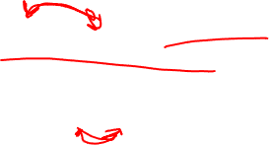
Candidate and Super Key
year month date major minor
2008 01 13 0 1
2008 04 23 0 2
2009 11 05 1 0
2010 04 05 1 1
(year, month, date)
(major, minor)

Slide 74
Dependencies: Definitions
Partial Dependency – Functional dependence in which a determinant is only part of the primary key
More straightforward and easy to identify
Partial Dependency

Slide 75
Dependencies: Definitions
Transitive Dependency – An attribute depends on another non-key attribute
Transitive Dependency

Slide 76
Conversion to First Normal Form
Identify and eliminate repeating groups
Group of multiple entries of same type can exist for any single key attribute occurrence
Steps:
Eliminate the repeating groups.
Identify a primary key.
Identify dependencies.

Slide 77
Conversion to Second Normal Form (2NF)
Steps
1. Make new tables to eliminate partial dependencies
2. Reassign corresponding dependent attributes
Table is in 2NF when it:
1. Is in 1NF
2. Includes no partial dependencies

Slide 78
Conversion to Third Normal Form (3NF)
Steps
1. Make new tables to eliminate transitive dependencies
2. Reassign corresponding dependent attributes
Table is in 3NF when it:
1. Is in 2NF
2. Contains no transitive dependencies

Slide 79
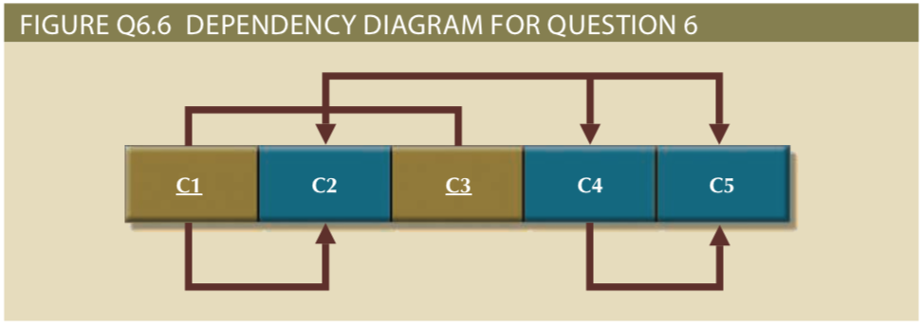
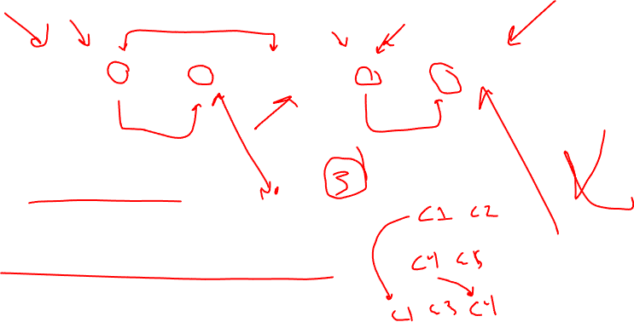
What are partial dependencies?
What are transitive dependencies?

Slide 80
Surrogate Keys
System-defined attribute
Used by designers when the primary key is considered to be unsuitable
Created an managed via the DBMS
A numeric value which is automatically incremented for each new row
Can create anomalies without thoughtful use and indexing

Slide 81
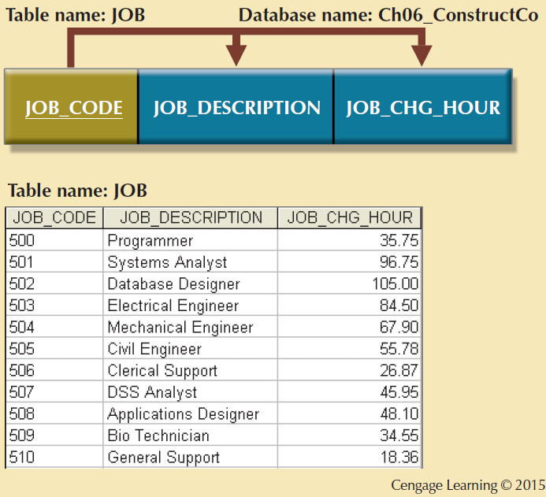
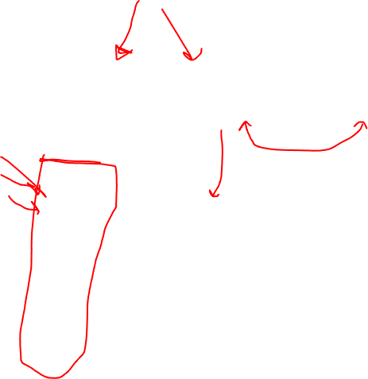
JOB_CODE

Slide 82


EMP_NUM

